Slide 1
NE 763: Advanced Reactor Materials
Fall 2026
Dr. Benjamin Beeler

Slide 2
molten salts

Slide 3
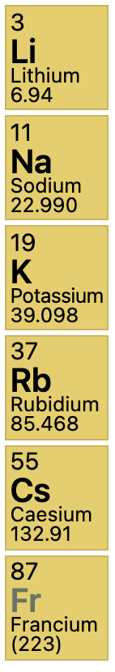
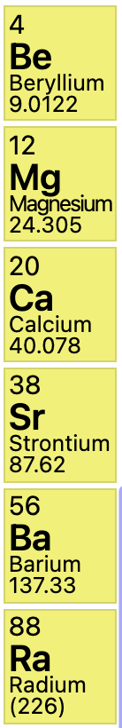
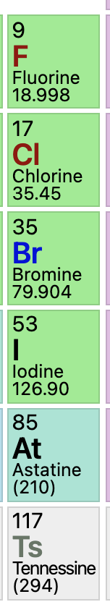
What are molten salts?
Alkali Metals
Alkaline Earths
Halogens
Salts are ionic compounds formed from a combination of electronegative and electropositive elements
At elevated temperatures salts liquefy and are termed “molten salts”
Halide salts are ionic compounds formed from the combination of a halogen (electronegative) and another electropositive element – commonly, but not exclusively, alkali metals or alkaline earths
Examples: LiF, BeF2, MgCl2, NaCl (aka table salt), ZrF4, RbF, UF4, UCl3

Slide 4
Molten Salt Reactors
Salt Cooled Reactor
Driven by some traditional fuel type in cladding, where the coolant is replaced with molten salt
Static Salt Fueled Reactor
The fuel itself is a liquid actinide-salt mixture contained in a cladding, often coupled with a salt coolant
Flowing Salt Fueled Reactor
The fuel itself is a liquid actinide-salt mixture which flows in a loops through the core and doubles as the coolant

Slide 5
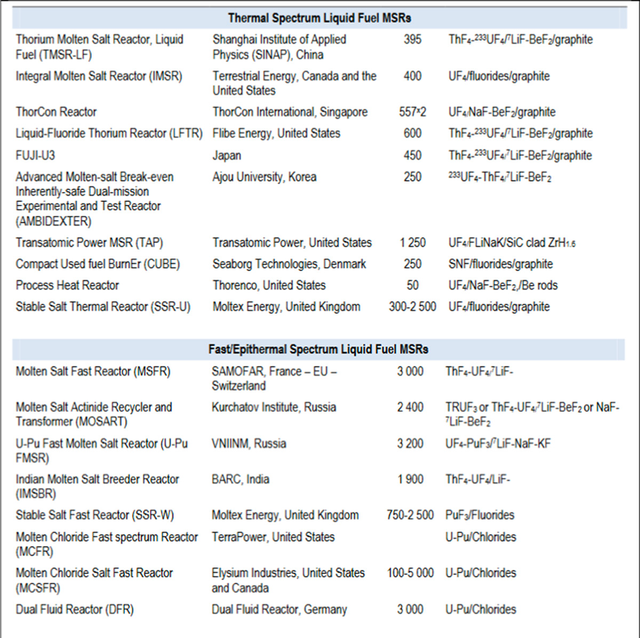
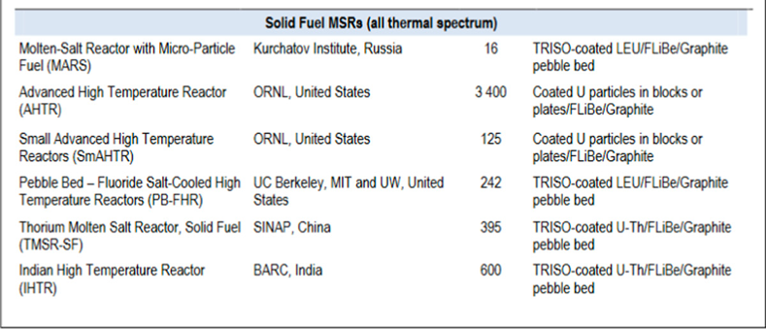
Thermal and Fast
Often salt reactors are further subdivided into fast and thermal spectrum reactors
List of examples of reactor systems with solid fuel, thermal liquid fuel, and fast liquid fuel

Slide 6
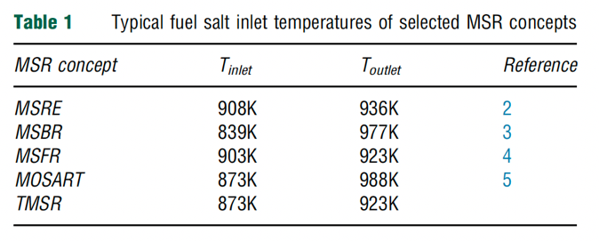
Benefits of MSRs
MSRs operate at or close to atmospheric pressure, rather than the 75-150 times atmospheric pressure of typical light-water reactors (LWR)
This reduces the large, expensive containment structures used for LWRs
Radioactive fission gases can be naturally absorbed into the molten salt
MSRs can have higher operating temperatures than a traditional LWR, providing higher electricity-generation efficiency, the possibility of grid-storage facilities, economical hydrogen production and, in some cases, process-heat opportunities.
MSRs have a strong negative reactivity feedback coefficient induced by the thermal expansion of the fluid
Backup safety measure of dump tanks for rapid removal of fuel
Possibility of online refueling and waste removal, plus benefits of reprocessing

Slide 7
Design/Nomenclature
When people refer to an MSR, they usually mean a thermal, fluoride-fueled, flowing loop reactor
This is due to historical reasons, as we will discuss
Thus, we have, unless otherwise specified: a liquid fuel with fission species dissolved in the salt; the fuel being pumped through and out of the reactor to a primary HX; secondary loop is typically also a molten salt and goes to a heat exchanger; tertiary loop is your steam turbine loop

Slide 8
Challenges of MSRs
The corrosivity of hot salts can break down cladding components and leech alloying elements
The changing chemical composition of the salt as it is transmuted by reactor radiation leads to changing properties
The processing of liquid transuranic molten salt fuel from the current spent fuel and the on-line reprocessing of MSR fuel need to be solved

Slide 9
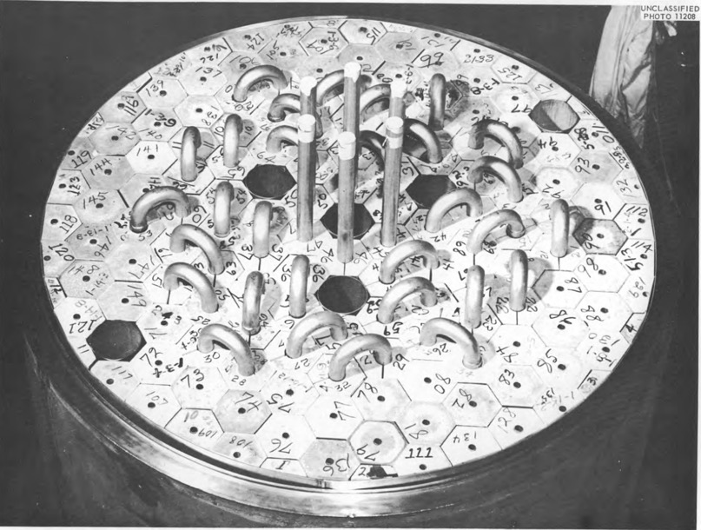
Beginning of MSRs
Aircraft Reactor Experiment (1954) was a 2.5 MWth thermal-spectrum nuclear reactor experiment designed to attain a high power density and high output temperature for use as an engine in a nuclear-powered bomber aircraft
It used the molten fluoride salt NaF-ZrF4-UF4 (53-41-6 mol%) as fuel, was moderated by a hexagonal-configuration beryllium oxide (BeO), and had a peak temperature of 860C

Slide 10
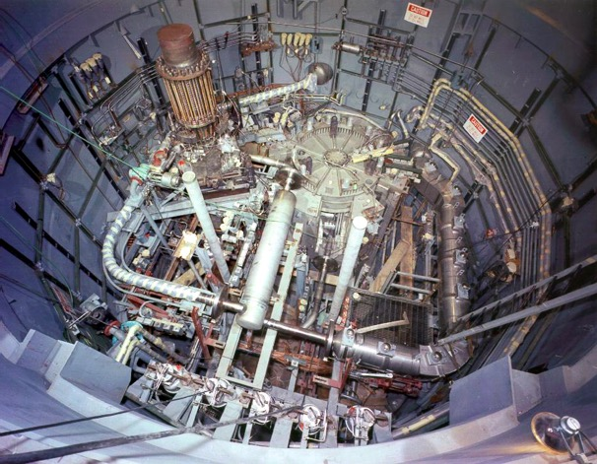
MSRE
The Molten-Salt Reactor Experiment (MSRE) was an experimental molten salt reactor at the Oak Ridge National Laboratory (ORNL); it went critical in 1965 and was operated until 1969

Slide 11
MSRE
MSRE was a circulating fuel type, utilizing LiF-BeF₂-ZrF₄-UF₄
The secondary coolant salt was LiF-BeF₂ (FLiBe), and the moderator was graphite
Salt-facing components were made of Hastelloy-N, which is a low chromium, nickel–molybdenum alloy

Slide 12
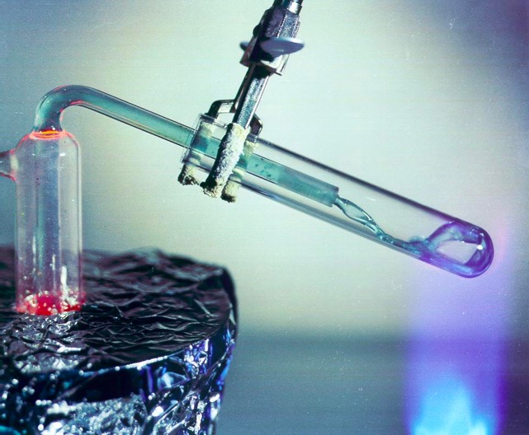
Fuel and Coolant Salts
A fuel salt is a molten salt that contains fissile material
Fuel salts consist of a mixture of some of all of the following:
  Fissile material
  Fertile material
  Solvent (Lowers melting point, Decreases power density, Decreases viscosity)
  Oxidation prevention material
  Fission products
Coolant salts are molten salts with advantageous heat transfer properties

Slide 13
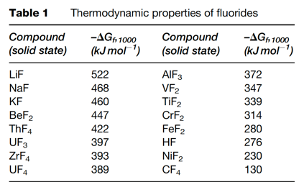
Fuel Salt Requirements
Low neutron absorption of non-fissile species
Radiolytic/thermal stability under in-core conditions
Dissolve fissile materials
High heat capacity, high boiling point, high thermal conductivity fluids
Melting point below ~525C
Low vapor pressure
Relatively insensitive to fission products
Both fluoride and chloride salts, under mildly reducing conditions, are reasonably compatible with high temperature structural alloys and graphite

